Slide 1



Stiften Donation Dapp
Final Year Project
By -
Aman Sharma Aanchal Giri
1803211007
1803211001
Final Presentation
Under the supervision of -
Mr. Ashwin Pirti Under the co- supervision of -
Mr. Rahul Sharma

Slide 2




ABES Engineering College
About Stiften
Stiften is an solidity based React.js decentralized application.
It is made to ease the problems regarding security and assurance of the donators money while donating in several organisations.
It will be used to make transanctions in both ethereum and indian rupees with ease.

Slide 3

ABES Engineering College
Solution
Stiften solves all the problem regarding the organization integirity, you can check where does the organization uses your money
01
Integirity
Problem
Too much
insecurity regarding the
Stiften solves your privacy problems. You can donate anonymously and your information will be safe with us
02
Confidentiality
right use of your money
Crypto Currency Barrier
Stiften solves your currency barriers, now you can pay in both indian cuurency and crypto currency
03

Slide 4

ABES Engineering College
Technology Stack
FrontEnd
BackEnd
Database
React.js Next.js
Node.js Express.js Solidity
MongoDB BlockChain Server

Slide 5

Methodology
ABES Engineering College
Step 1
Step 2
Step 3
Making contracts for adding oranizations and making transactions with ethereum.
Making api for adding authentication in app and adding payment gateway and showing recent transactions by user.
Making frontend for the application making admin, organisation and client side and then integrating backend with the front end.

Slide 6
ABES Engineering College
Architecture
Different portals for customers, organizations, and admin.
Authentication will be implemented.
Customers
Customers will be a number of organizations and NGOs
Each organization will have a details page.
The organisation list will have the two filters one for nearest to customer location and the second will be through ratings.
Customers can rate the NGO or organisation
Customer can pay in indian currency as well as cryptocurrency.
Customers can participate in the ngo activities that
are near them through participation tab.
Features to be implemented
These are the following features well thought to be implemented in this project

Slide 7
ABES Engineering College
New Organisations can apply to this app.
They can update their information about them. They can add new activities that will be performed by them.
New voulunteer can be accepted by them and that volunteer's contact will be shared to them.
Organisations
Features to be implemented
Admins can add new organizations and accept the application of organisations and NGOs.
Admins will verify user and can deactivte account of user due to inactivity.
Admins can monitor all the transactions and provide the receipt.
Admins
These are the following features well thought to be implemented in this project

Slide 8
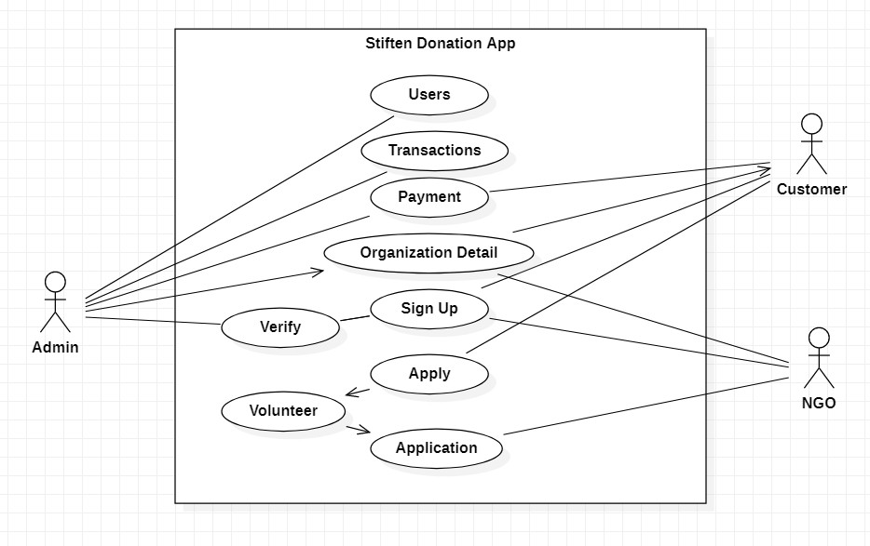
ABES Engineering College
Use Case Diagram
use-case diagrams model the behavior of a system and help to capture the requirements of the system

Slide 9
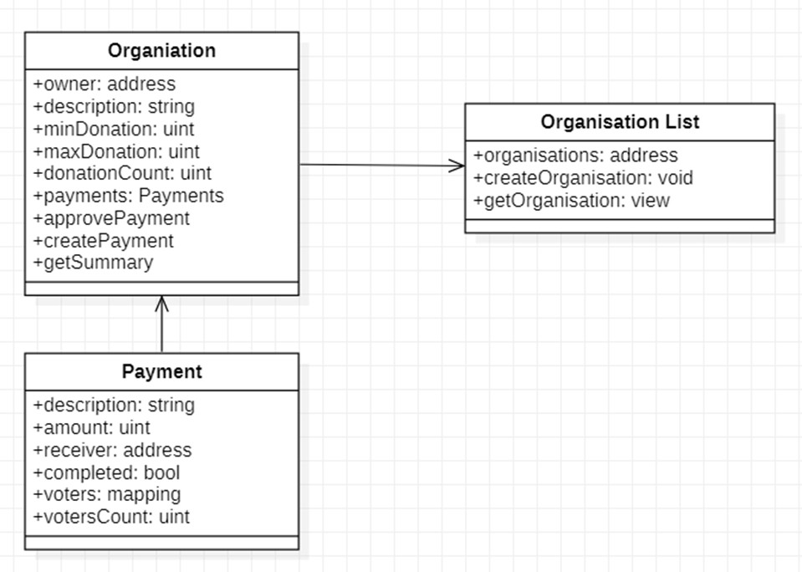
ABES Engineering College
Class Diagram
General conceptual modeling of the structure of the application

Slide 10
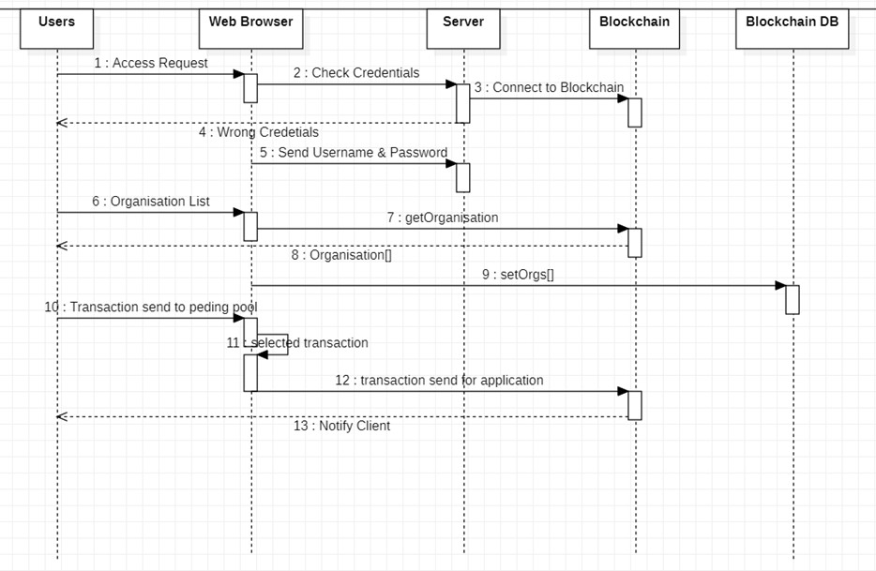
ABES Engineering College
Sequence Diagram
The scenario and the sequence of messages exchanged between the objects needed to carry out the functionality of scenario

Slide 11
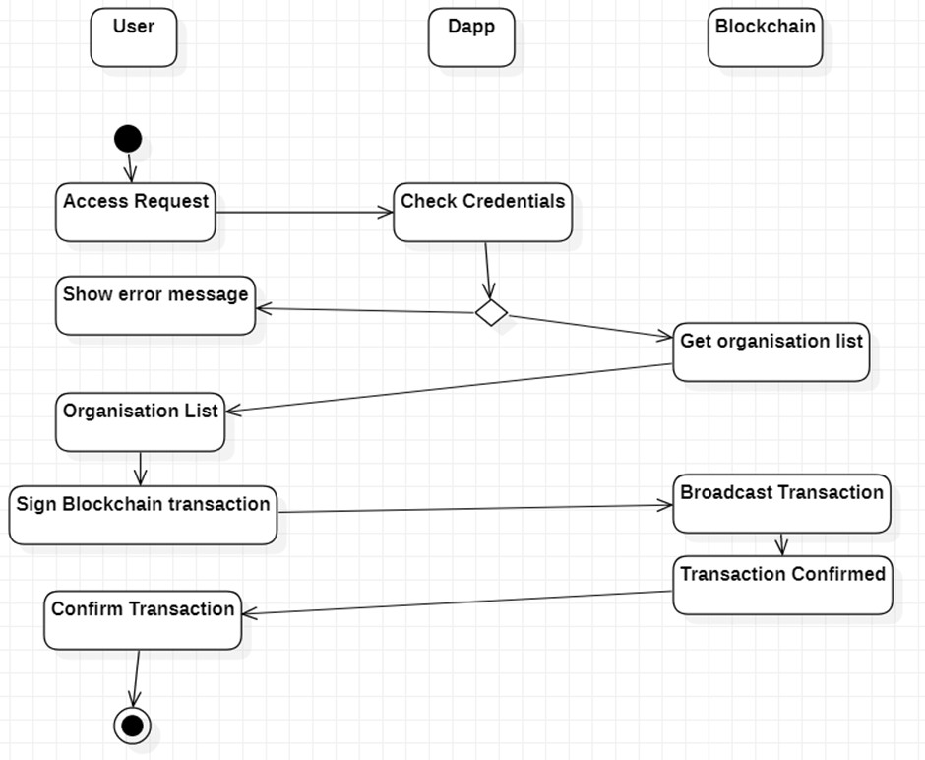
ABES Engineering College
Activity Diagram
portrays the control flow from a start point to a finish point showing the various decision paths that exist while the activity is being executed

Slide 12
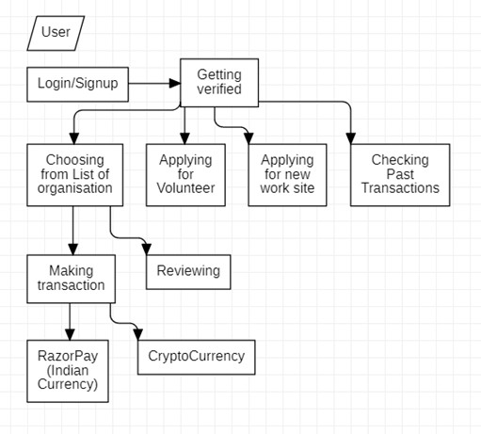
ABES Engineering College
Data FLow Diagram
maps out the flow of information for any process or system

Slide 13
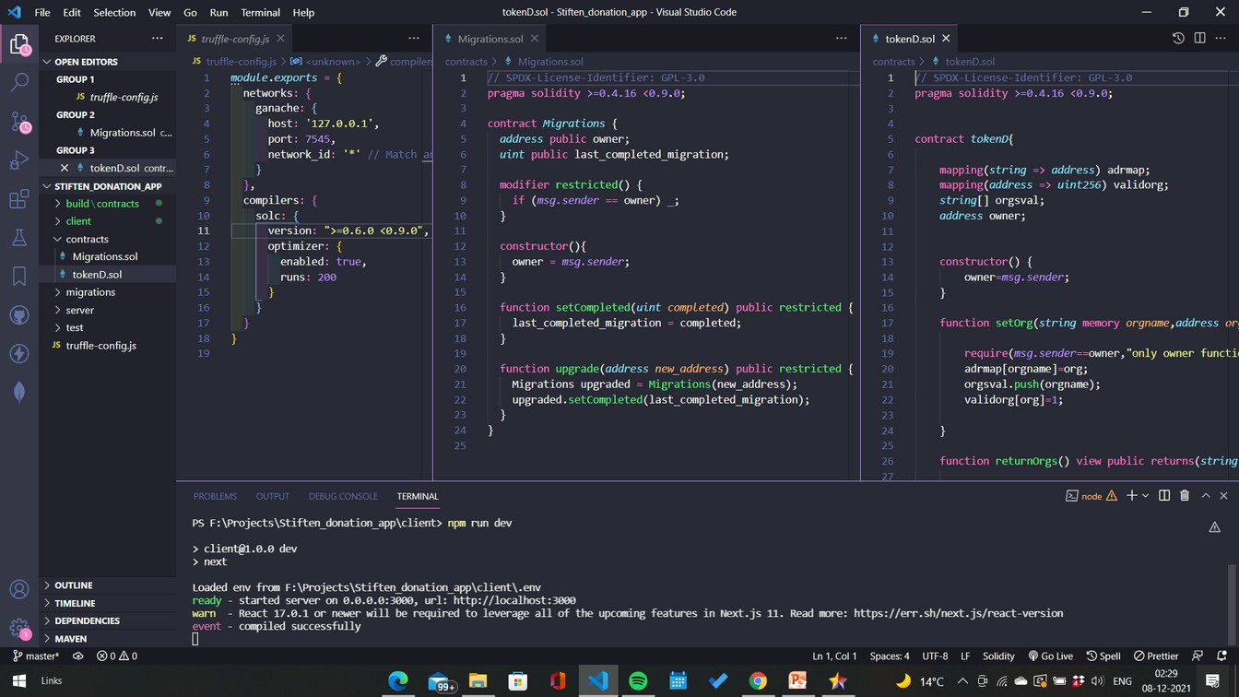
Implementation
Till Date
ABES Engineering College
This is the Blockchain backend made on solidity. Two contracts are written with various function

Slide 14
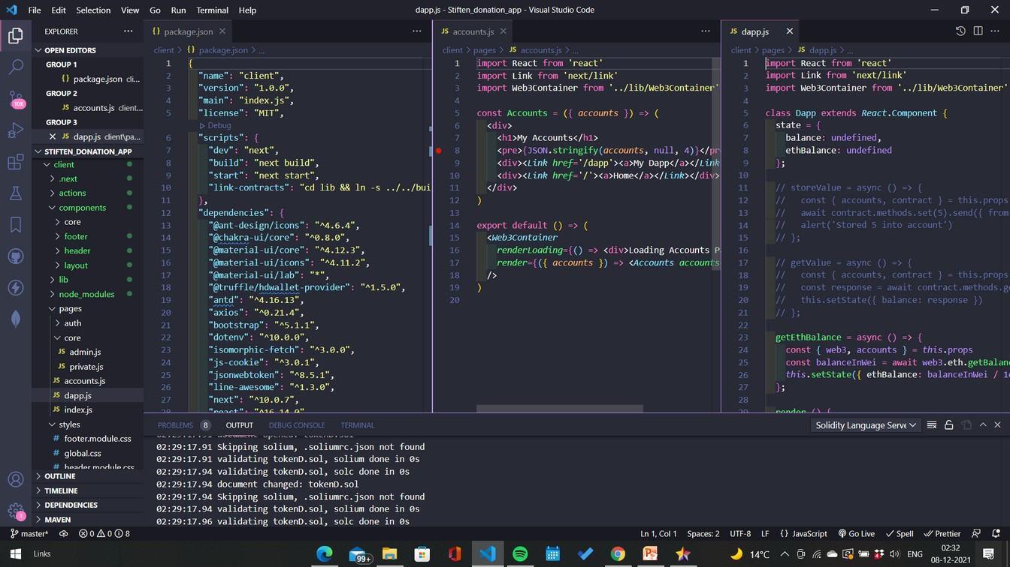
Implementation
Till Date
ABES Engineering College
This is the front end part of the application made on next.js.
This screen has the code in
which the solidity backend was tested

Slide 15
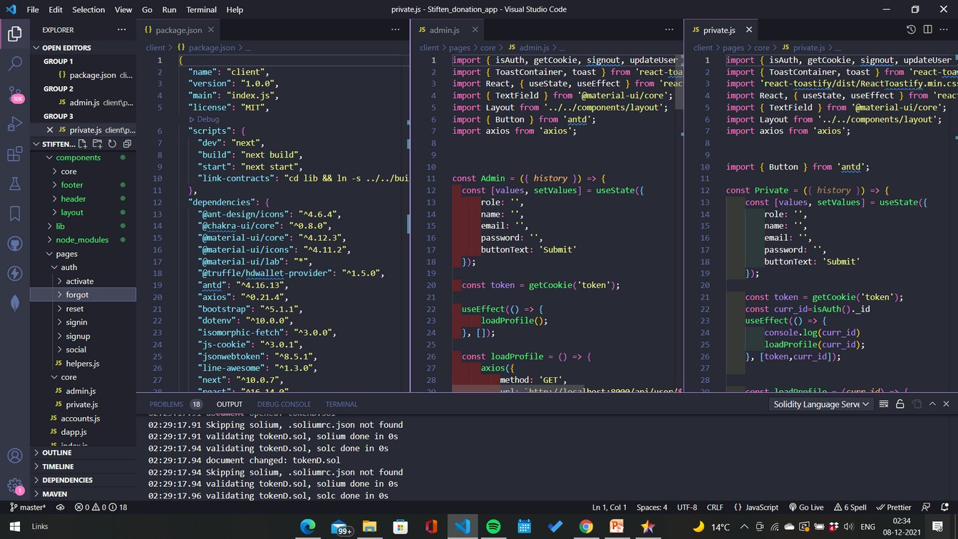
Implementation
Till Date
ABES Engineering College
This attached screen has the code in which the auth api were tested and the auth of frontend is

Slide 16
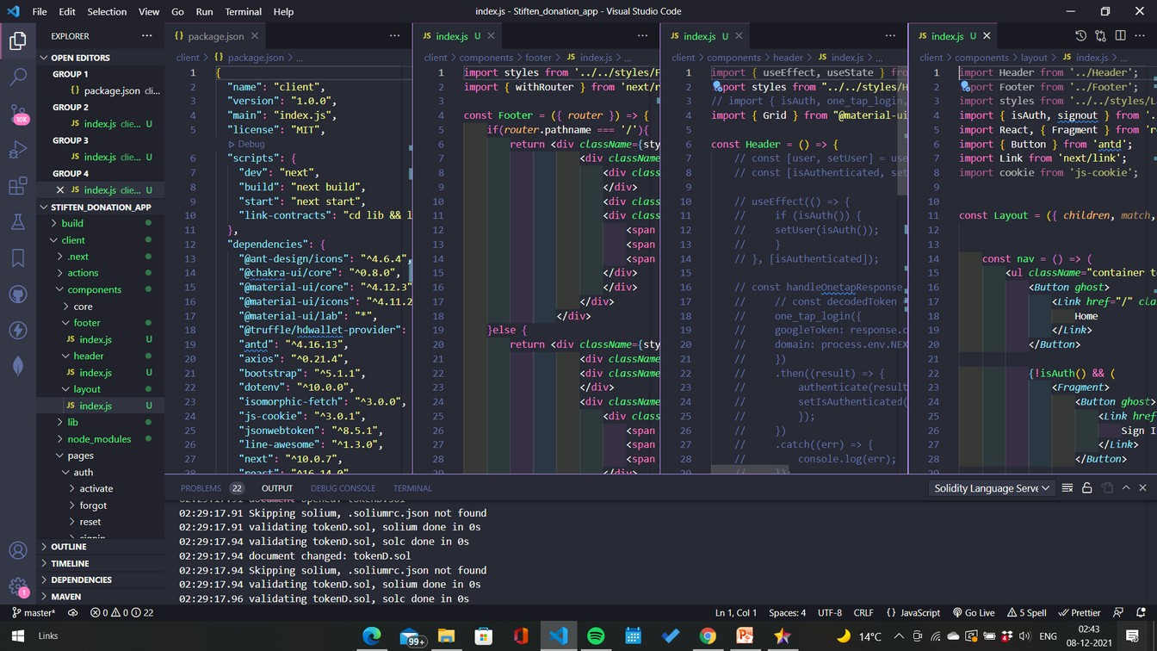
Implementation
Till Date
ABES Engineering College
This attached screen has the code in which the layout of the application is set up.

Slide 17
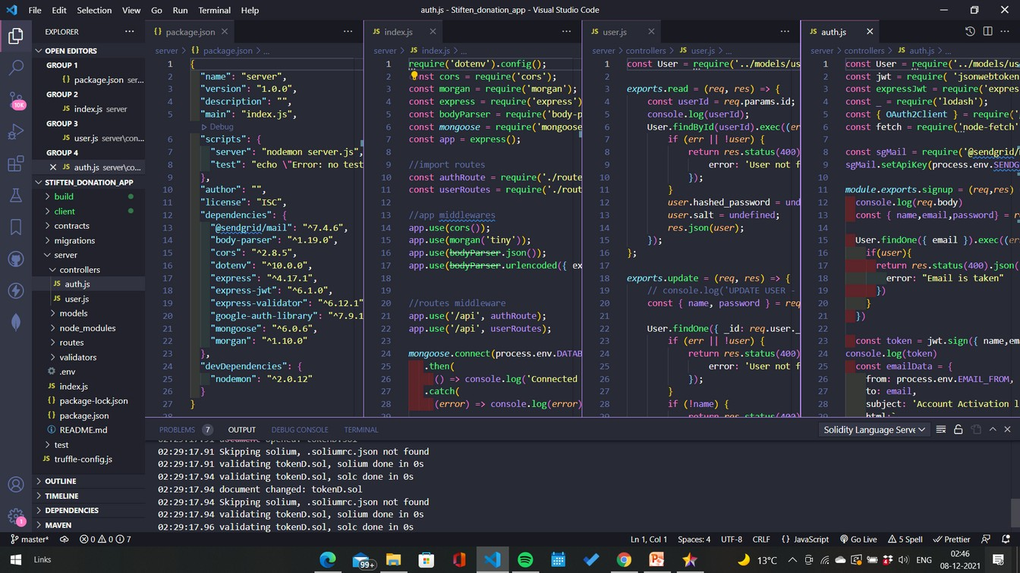
Implementation
Till Date
ABES Engineering College
This is the backend part of the application made on express.js. This screen has the code in which the controllers of the auth and users are set up.

Slide 18
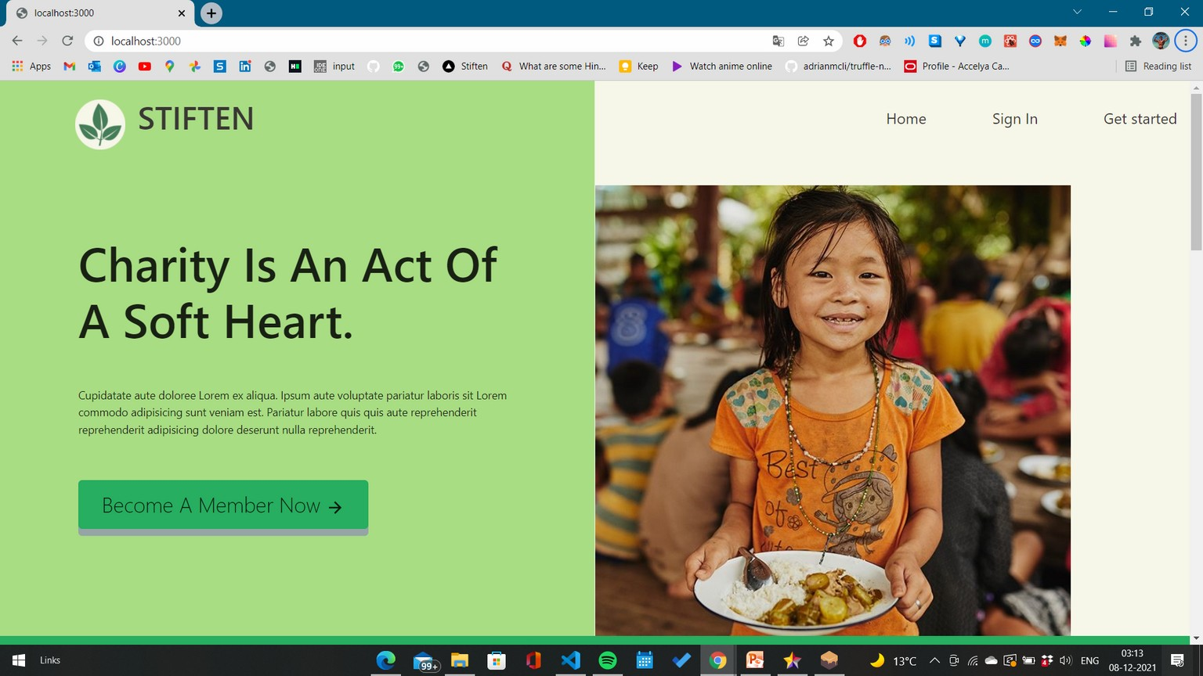
ABES Engineering College
Implementation
Till Date
UI

Slide 19
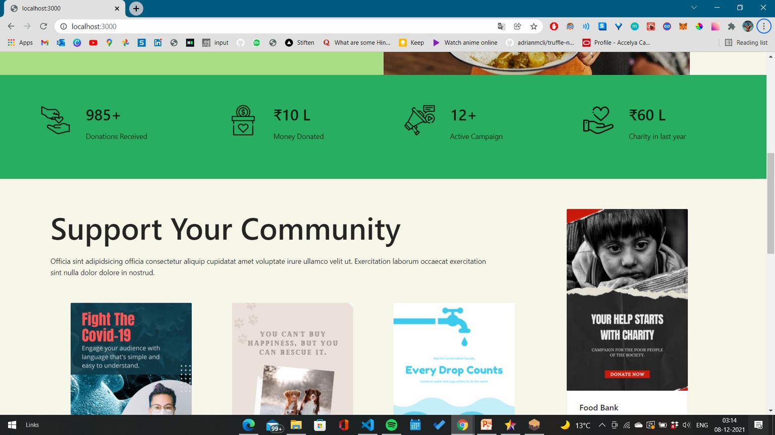
ABES Engineering College
Implementation
Till Date
UI

Slide 20
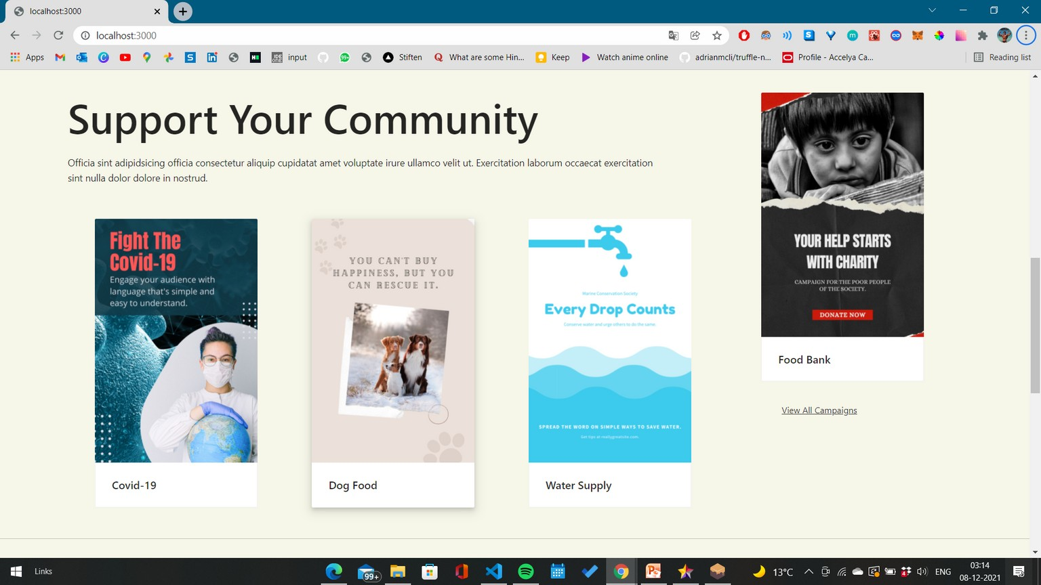
ABES Engineering College
Implementation
Till Date
UI

